Slide 1

Engineering Codex
Domain Storytelling
d
g
x

Slide 2




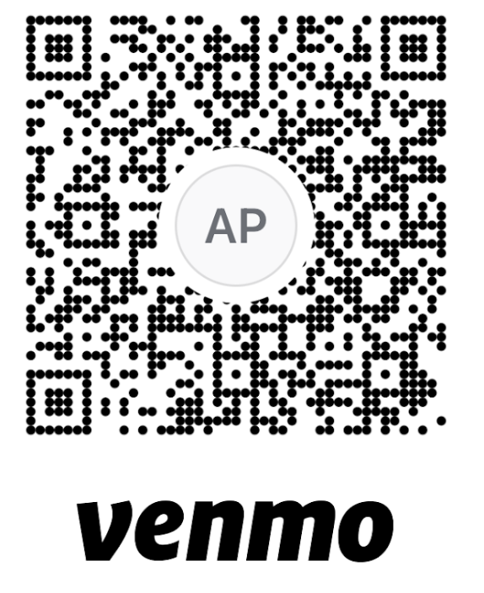
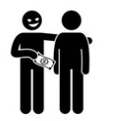


My goal is to empower you, with some actionable knowledge,
and inspire your curiosity
I’m happy to reiterate
any content, just ask.
I can take questions while i’m presenting.
I encourage discussion and active participation,
but please be kind.
To finish earlier...

Slide 3
“It’s developers’ (mis)understanding, not expert knowledge that gets released in production.”
— Alberto Brandolini

Slide 4
Domain Knowledge
Domain
Experts
Code
GDX embraces Domain Driven Design. Our Complex ecosystem is divided into a series of domains, or bounded contexts.
Bounded Contexts help focus our creativity into a space where we can maximize our impact.
It is within these bounded contexts that we seek to deliver solutions to various business problems.
In order to solve our business’ problems, we strive to achieve a ubiquitous or common language that can be shared across all domain contributors and contributions.
Shared Model
Ubiquitous Language
Developers
Stakeholder

Slide 5
Domain Storytelling is a collaborative technique to transform domain knowledge into business software

Slide 6
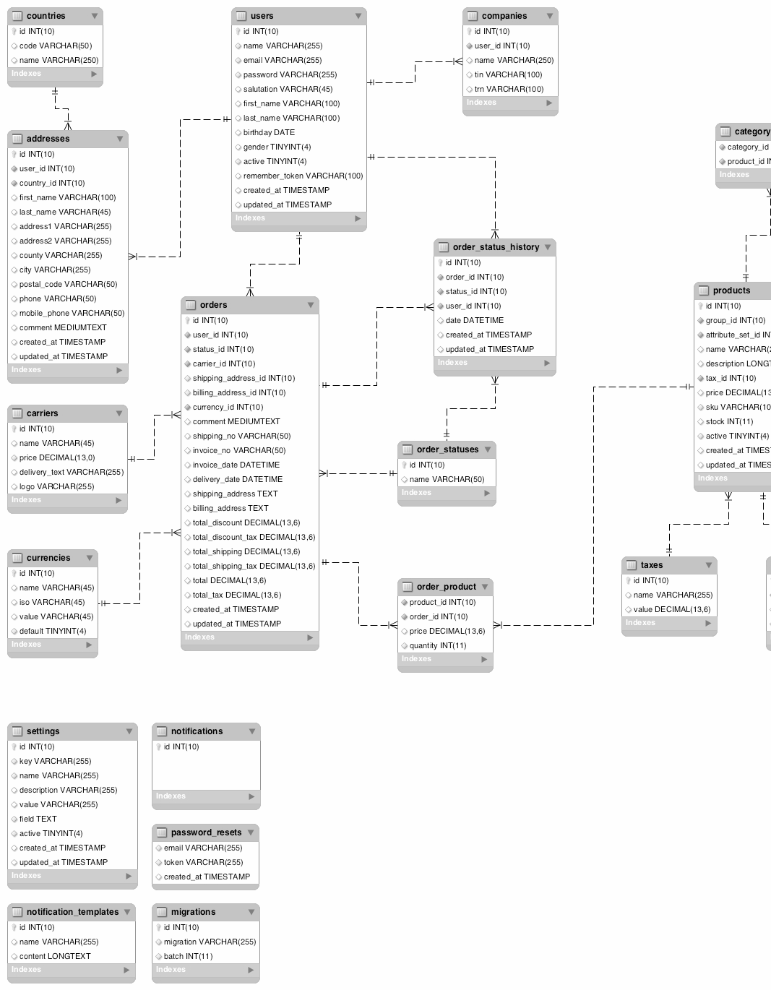

The Objective

Slide 7
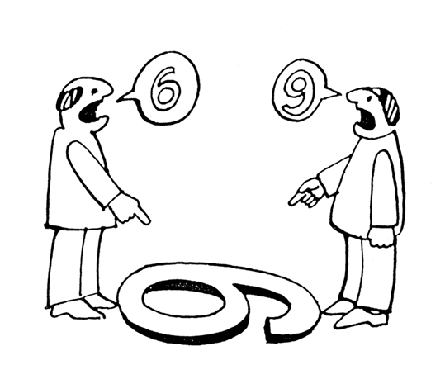
The Problem is a Lack of Shared Context

Slide 8
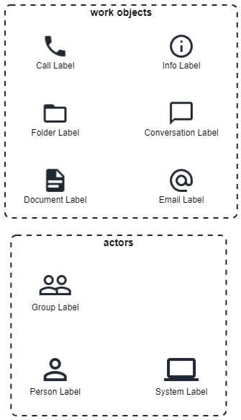
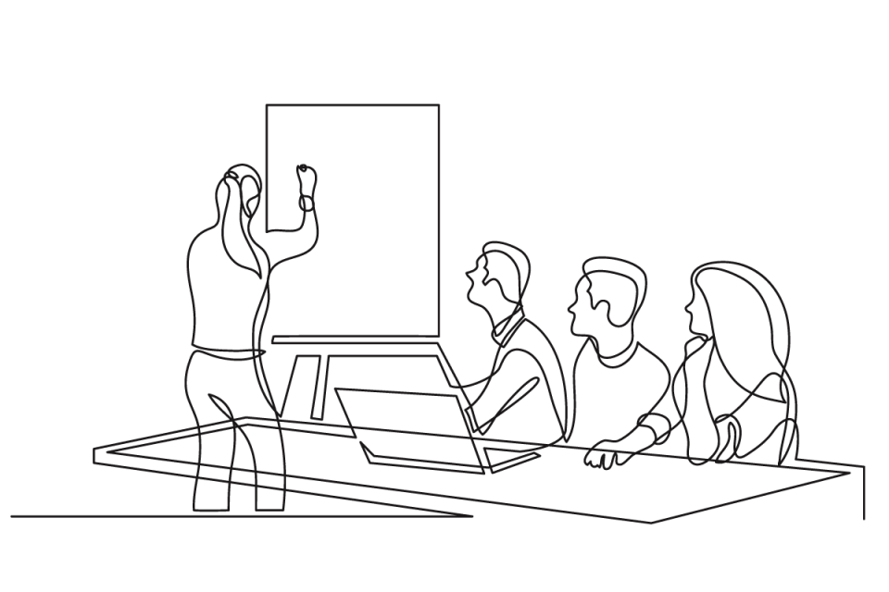
A Domain story is told in a workshop, where we visualizes who (actor) does what (activity) with what (work objects) with whom (other actors)
Workshop
activity
[verb]
The Domain Storytelling Toolkit Aims to Provide a Common Context

Slide 9
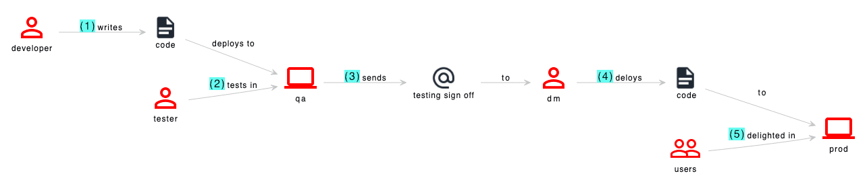
Actors
```plantuml
@startuml
!$Actor_IconColor = 'red'
!include https://raw.githubusercontent.com/johthor/DomainStory-PlantUML/main/domainStory.puml
Person(developer)
Person(tester)
Group(users)
System(qa)
System(prod)
Person(dm)
Document(code)
Email(so, testing sign off)
activity(+, developer, writes, code, deploys to, qa)
activity(+, tester, tests in, qa)
activity(+, qa, sends, so, to, dm)
activity(+, dm, deloys, Document: code, to, prod)
activity(+, users, delighted in, prod)
@enduml
```
Actors create, work with, and/or exchange work objects
They appear in a diagram only once

Slide 10
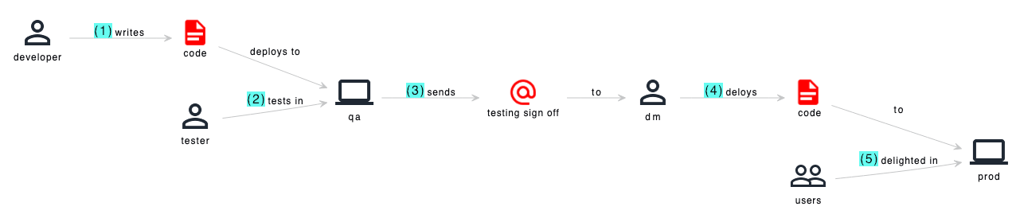
Work Objects
```plantuml
@startuml
!$Object_IconColor = 'red'
!include https://raw.githubusercontent.com/johthor/DomainStory-PlantUML/main/domainStory.puml
Person(developer)
Person(tester)
Group(users)
System(qa)
System(prod)
Person(dm)
Document(code)
Email(so, testing sign off)
activity(+, developer, writes, code, deploys to, qa)
activity(+, tester, tests in, qa)
activity(+, qa, sends, so, to, dm)
activity(+, dm, deloys, Document: code, to, prod)
activity(+, users, delighted in, prod)
@enduml
```
Work objects can appear multiple times in a diagram
This keeps the images more consumable, but more importantly a work item might appear in different states or forms during different actions

Slide 11
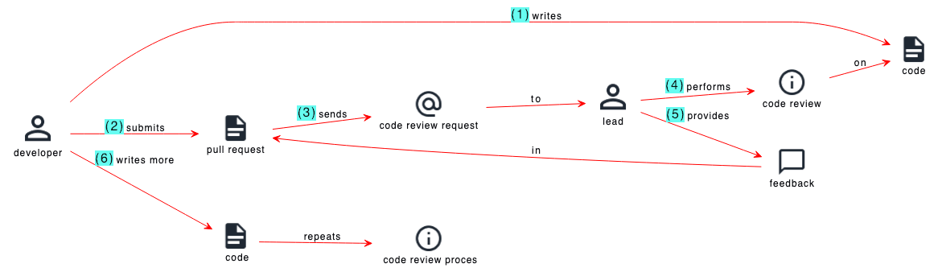
Activities
```plantuml
@startuml
!$Activity_Color = 'red'
!include https://raw.githubusercontent.com/johthor/DomainStory-PlantUML/main/domainStory.puml
Person(developer)
Person(lead)
Document(code)
Document(pr, pull request)
Info(review, code review)
Conversation(feedback)
Email(request, code review request)
activity(1, developer, writes, code)
activity(2, developer, submits, pr)
activity(3, pr, sends, request, to, lead )
activity(4, lead, performs, review, on, code)
activity(5, lead, provides, feedback, in, pr)
activity(6, developer, writes more, Document: code, repeats, Info: code review process)
@enduml
```
Activities are the sentences we form to describe a story.
They are sequenced in chronological order
Start with the highest level scope first, and drill down
There are no conditionals when creating activities. Generally start with the happy path, and if variations do occur, then we can generate new story diagrams later.

Slide 12
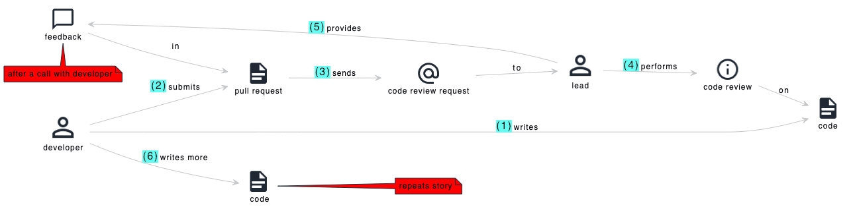
Annotations
```plantuml
@startuml
!$Note_BackgroundColor = 'red'
!include https://raw.githubusercontent.com/johthor/DomainStory-PlantUML/main/domainStory.puml
Person(developer)
Person(lead)
Document(code)
Document(pr, pull request)
Info(review, code review)
Conversation(feedback)
Email(request, code review request)
note bottom of feedback: after a call with developer
activity(1, developer, writes, code)
activity(2, developer, submits, pr)
activity(3, pr, sends, request, to, lead )
activity(4, lead, performs, review, on, code)
activity(5, lead, provides, feedback, in, pr)
activity(6, developer, writes more, Document: code, $note=repeats story)
@enduml
```
Activities are the sentences we form to describe a story.
They are sequenced in chronological order
Start with the highest level scope first, and drill down
There are no conditionals when creating activities. Generally start with the happy path, and if variations do occur, then we can generate new story diagrams later.

Slide 13
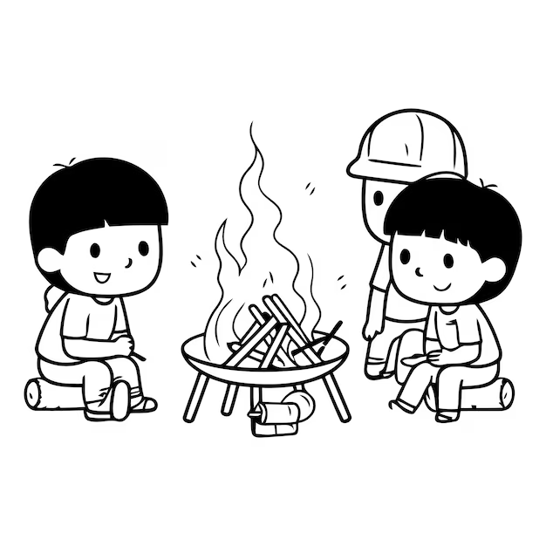
Workshop
Have the right people
  Facilitator
  Domain Expert
  Actors
Keep the Story Going
  What happens next?
  How do you get this information?
Employ active listening
  Retell the story to confirm the diagrammed understanding
Use whatever tools make sense to your group

Slide 14
A Common Context Requires a Common

Slide 15
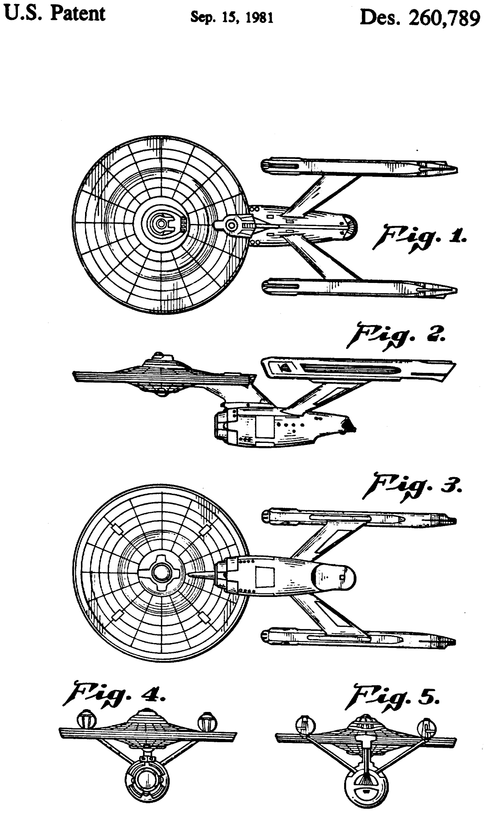
“Communication is a matter of patience and imagination.”
— Jean Luc Picard

